Slide 1
Internship: Final Presentation Duration:- 6 weeks(13th June – 22nd July 2022)
Department: Online Safety(Recommender Systems)
7/22/2022

Slide 2
Agenda
Internship Task
Introduction to Network Visualization
Practical Steps
Data Structure
Data Visualizations and Results
Lessons Learnt
Challenges

Slide 3
Internship Task
Use the MovieLens data set to create a network visualization to help understand
Understand user-user relationships
Understand Movie-Movie relationships.
The output should be a nice network graph visualization that individuals can interact .
Ideally the result should show movies which are similar to each other but isolated from the rest of the movies and a similar thing for users.
The work was done to support the recommender system project.

Slide 4
Network Visualizations
Network visualization, graph visualization or link analysis is the process of visually presenting networks of connected entities as links and nodes. Nodes represent data points and links represent the connections between them.
You can quickly and easily identify relationships between related items and clusters by displaying your data with a network visualization.
Networks graphs are extremely useful in use cases such as intelligence analysis (e.g., one person is an associate of a suspect or known criminal), fraud detection (e.g., the same social security number was used by different people), social network analysis and many others.

Slide 5
Practical steps taken throughout the project
Data and data pre-processing
Data Exploration
Data Manipulation to structure data in the required format
Using the Cosine Similarity to analyse user to user and movie to movie relationships.
Data Visualizations using Argolite and Networkx

Slide 6
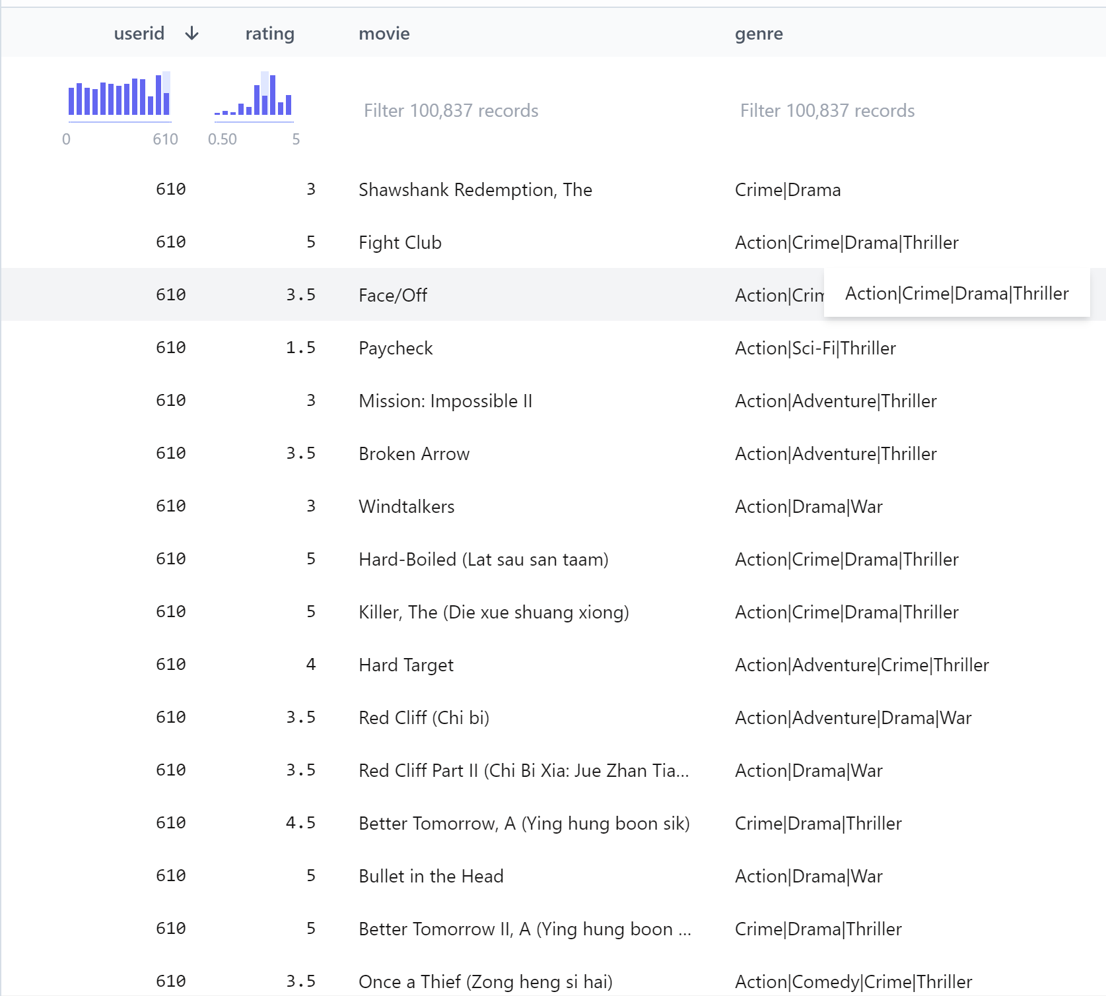
Data structure
The MovieLens Dataset is most often used for the purpose of recommender systems which aim to predict user movie ratings based on other users’ ratings. In other words, we expect that users with similar taste will tend to rate movies with high correlation.
The dataset used in this project includes User ratings and genres of each of this movies found in the dataset.

Slide 7
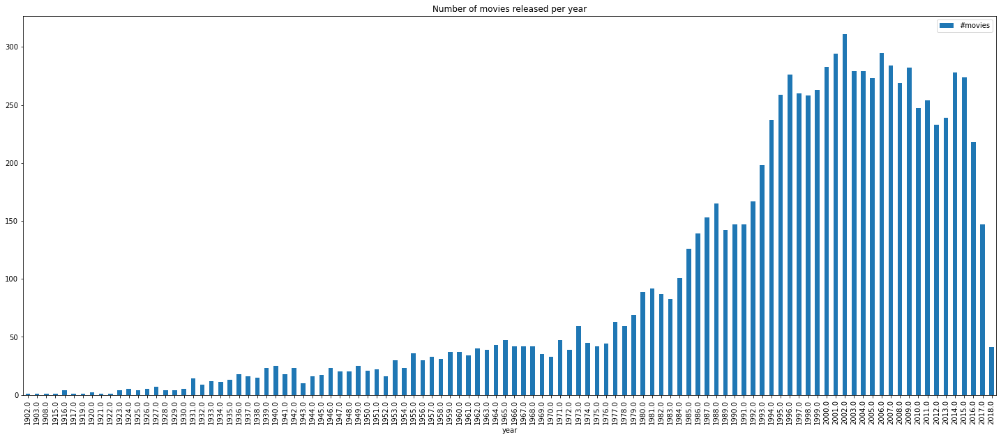
Basic Info:- Number of movies released per year

Slide 8
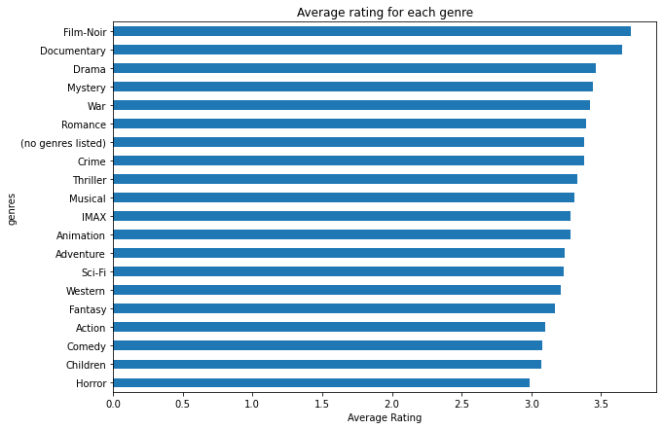
Basic Info:- Average Rating for each Genre

Slide 9
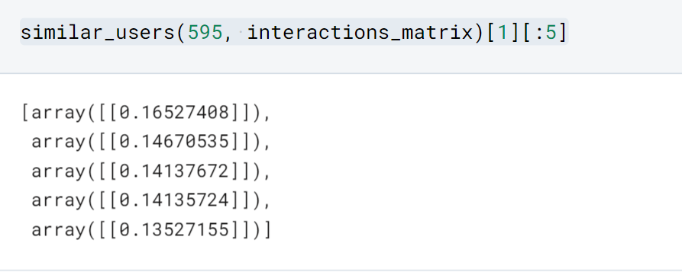
Cosine Similarities
We will use the Cosine Similarity from Sklearn, as the metric to compute the similarity between two data points
Cosine similarity is a metric used to measure how similar two items are. Mathematically, it measures the cosine of the angle between two vectors projected in a multi-dimensional space. The output value ranges from 0–1.
0 means no similarity, whereas 1 means that both the items are 100% similar.
Results from the cosine similarities matrix were explored to plot network graphs of similar users and movies.

Slide 10
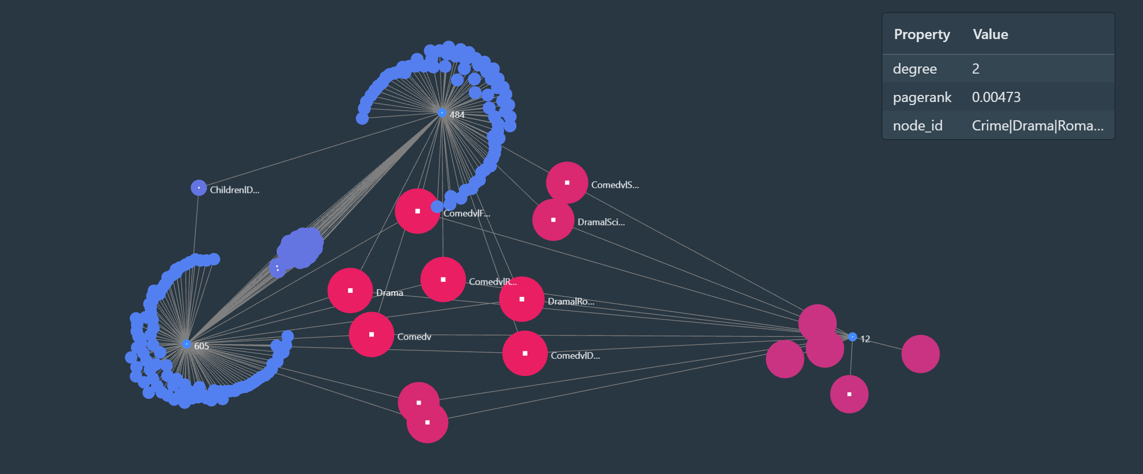
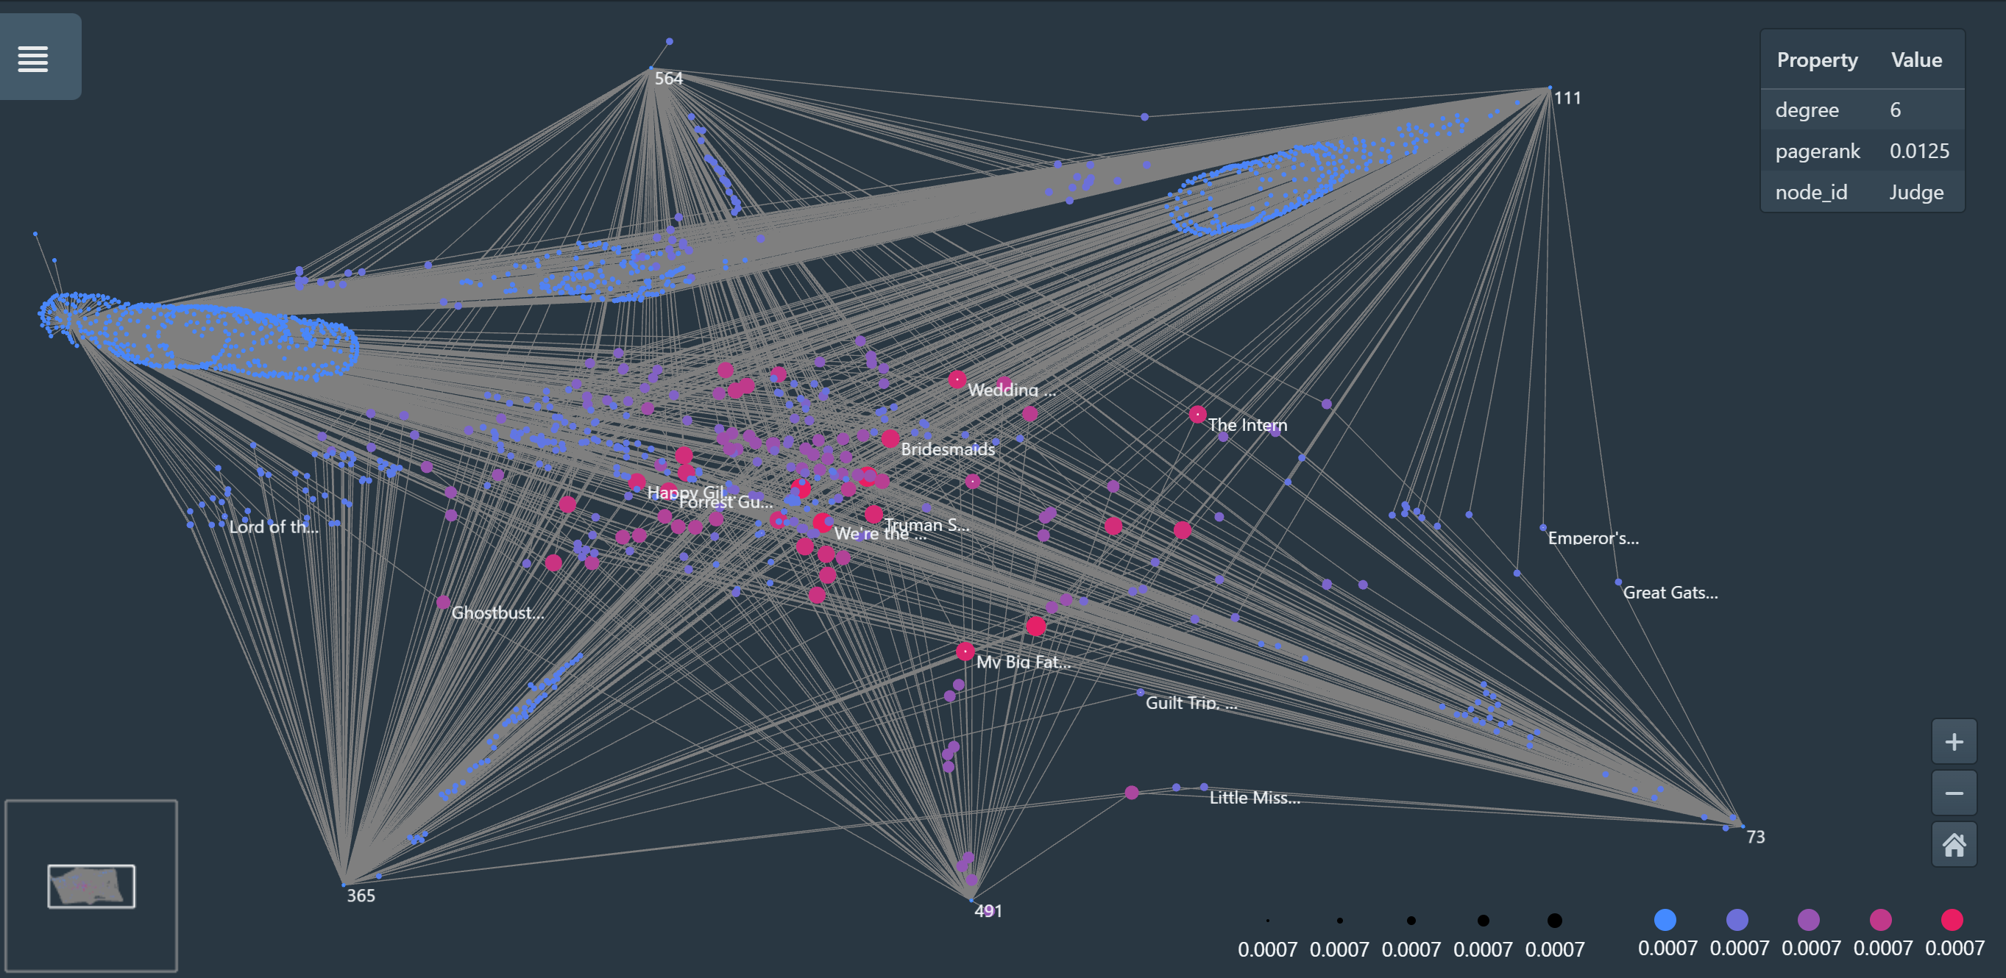
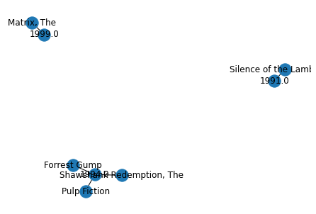
Implementation/Sample result
The graph above shows the similarities between users with low rating counts and the genres they rated.
The graph above shows a user-to-user similarity between 5 users. These users were seen to have rated similar movies in the dataset.
The top 5 most rated movies were all produced in the 1990s with three produced in the same year(1994)

Slide 11
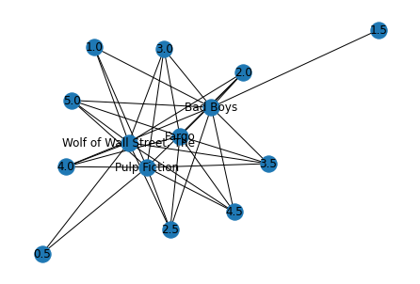
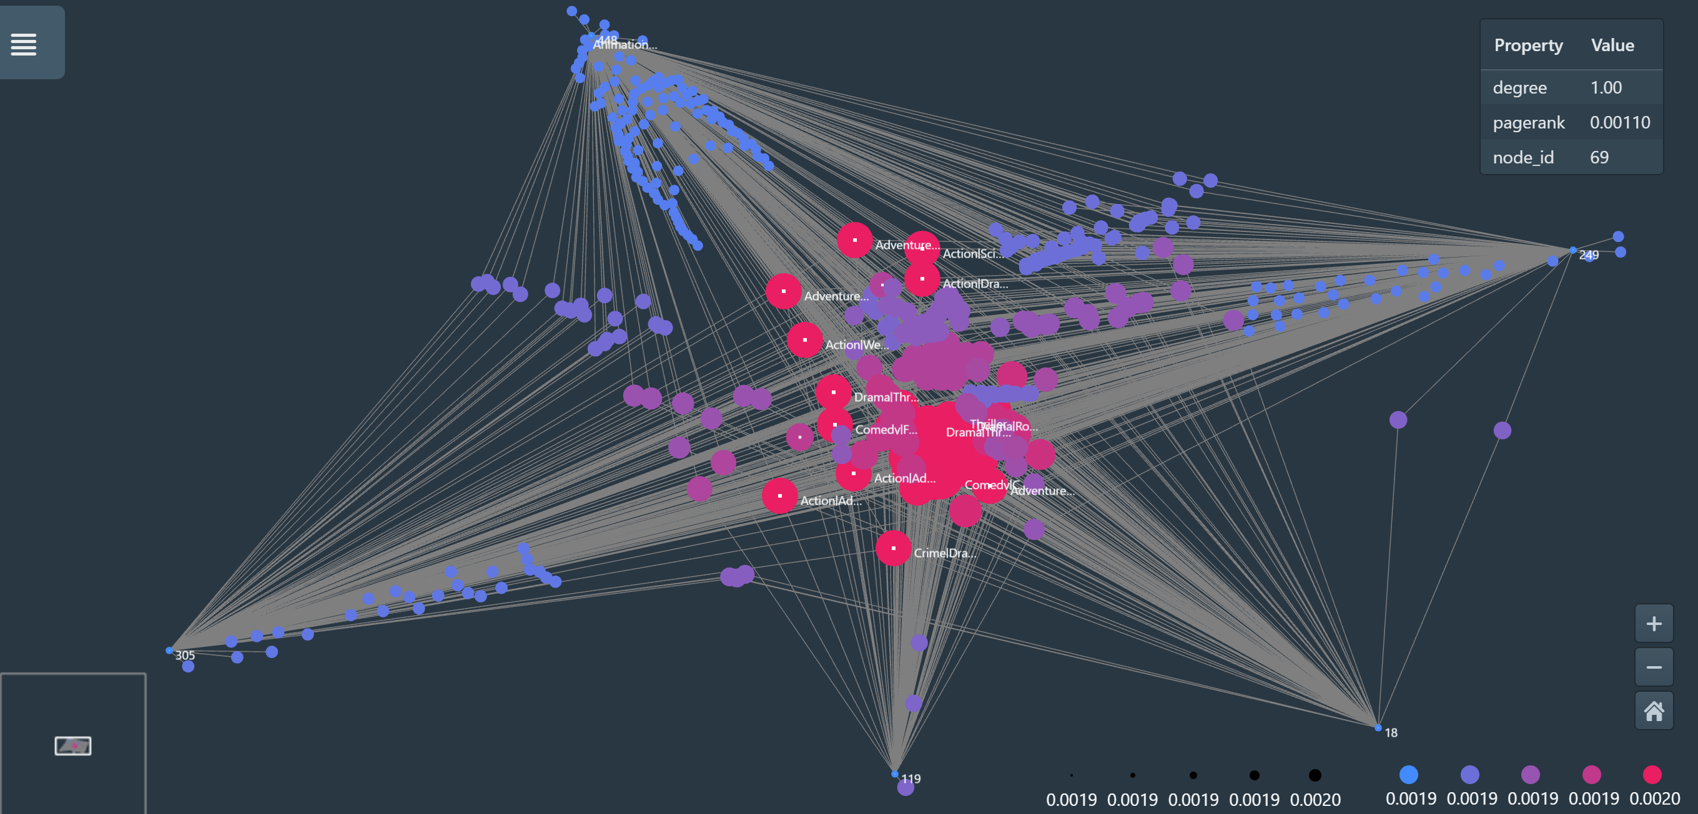
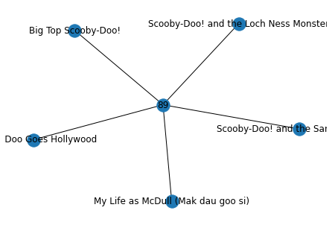
Implementation/Sample result
This particular movies with the genre ” Comedy|Crime|Drama|Thriller” had high ratings all over the dataset.
The movies in the graph above are all ‘Animation|Children|Comedy’ rated five by the user with id 89 over each decade. We can draw a conclusion that this user is a kid/teenager, or the user rated this movies with the younger for a younger generations preference in mind.
Users with id 18, 119, 249, 305 and 448 have major similarities in the genres on movies they rated.

Slide 12
What I Learned
Technical Skills
Network Graph libraries in Python
Latest trends in recommender systems
Working with Cosine Similarities
Network Visualization softwares and how to use them
Soft Skills
Communication Skills
Teamwork in an International Working Environment
Time Management
Decomposition(Breaking down of a problem into smaller parts)
What I learned about Ofcom
Ofcom has a whole team(economics) that thinks about the
economical effect of their decisions
Consumer & Market Intelligence
Use the MovieLens data set to create

Slide 13
Challenges
Use the MovieLens data set to create
Resources and Storage Restrictions
Lack of knowledge about network visualizations
Time Management

Slide 14
Thank You

